Slide 1
Corpus-specific Urdu FastText Embeddings for Toxic Comments Detection in Urdu.
Thesis-2
2022
Data Science Lab
Dept. of Computer Sciences (DCS)
Information Technology University, Lahore (ITU)

Slide 2
Project Team
Project Supervisor:
Dr. Faisal Kamran
Presented By:
Muhammad Usama Irfan

Slide 3
Contents
Introduction
Related Work
Contributions
Dataset
Classification Models
Experimental Details
Results
Conclusion

Slide 4
Introduction
Toxicity is communication in speech or text, that attacks or uses abusive or discriminatory language.
Targeted to a person or a group based on:
Religion
Ethnicity
Nationality
Race
Color
Gender
Other discriminatory factors.
Input
بچو کو بھوکا مار دو خود بھی مر جاؤ
Output
Toxic/Non-toxic
Notes:
Toxicity is defined as a communication in speech or writing that uses abusive or discriminatory language.
Directed to an individual or a group based on their religion ethnicity nationality race color gender or other features

Slide 5
Introduction
Toxic text detection studied extensively in English and various other resource-rich language.
Urdu and other local languages still lack attention of research community.
Prepared an extensive and diverse dataset for the Detection of Toxicity in Urdu language.
Input
سالے دوں کیا کھینچ کے ابھی چل جا
Output
Toxic/Non-toxic
Notes:
Topic is extensively studied in resource rich languages like english, french, spanish etc
While Urdu which is a local language lacks the attention of research community and is resource deficient

Slide 6
Motivation
Uncontrolled spread has emerged as an undesirable global social issue causing mental health problems and even suicides. [10]
Urdu is spoken as a first language by nearly 70 million people. [Britanica]
Second language by more than 100 million people, predominantly in Pakistan and India. [Britanica]
Urdu as Resource deficient language
Notes:
Motivation 3 aspects
Hate speech spread a global issue.
Causes mental health problems often leading to cases of suicide.
Focus on Urdu. A resource poor language but is widely spoken language.
70 Million people speak urdu as first language
More than 100 Million as second language

Slide 7
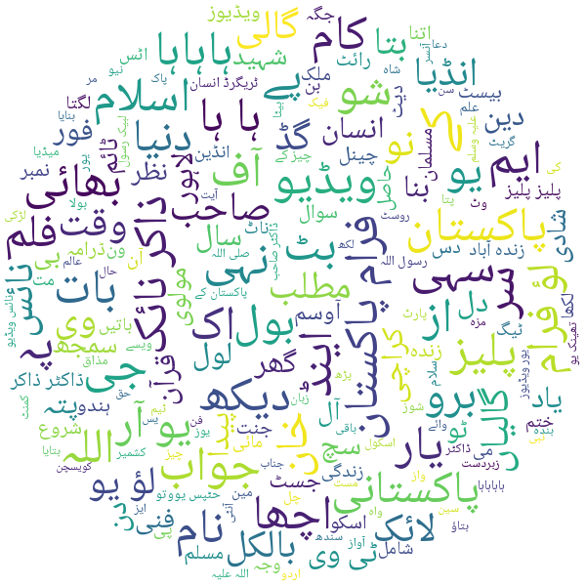
Problem Statement
We are given a dataset D of social media comments written in Urdu language.
The goal is to learn a function ( classification model ) to automatically label the given comments into toxic and non-toxic classes.
Notes:
Given a Dataset D having n Urdu comments, The goal is to learn function that automatically labels the comment to Toxic or Non-Toxic

Slide 8
Contributions
Toxic comment classification for an under-resourced Urdu language using Deep Learning.
Dataset/Resource generation for Urdu which lacks dataset for Toxicity detection in Urdu.
Extensive Empirical Analysis of various Deep Learning based techniques along with word embedding combinations.
Notes:
Contribution are three-fold
Worked on Toxicity Classification in under-resourced language like urdu using DL techniques.
Prepared an extensive and diverse Dataset for Urdu Toxic comments detection.
Performed Empirical Analysis of various Deep Learning techniques along with word embeddings.

Slide 9
Related Work
Multilingual detection of hate speech against immigrants and women in twitter (2019).
Two main classification tasks.
Binary task for hate speech detection and a finer-grained identifying features in hateful contents such as the aggressive attitude and the target harassed, to distinguish if the incitement is against an individual rather than a group.
CONAN - COunter NArratives through Nichesourcing: a Multilingual Dataset of Responses to Fight Online Hate Speech (2019)
Described the creation of the first large-scale, multilingual, expert-based dataset of hate-speech/counter-narrative pairs.
Oppose hate content with counter-narratives (i.e. informed textual responses).
Hate Speech Detection in Roman Urdu (2021)
Manually identified 5,000 Roman Urdu tweets from scrapped 90000 tweets.
Classified 3 levels: Neutral-Hostile, Simple-Complex, and Offensive-Hate speech.
Logistic Regression outperformed other techniques, including deep learning techniques for the two levels of classification, by achieved an F1 score of 0.906

Slide 10
Literature Review
CIC at SemEval-2019 Task 5: Simple Yet Very Efficient Approach to Hate Speech Detection, Aggressive Behavior Detection, and Target Classification in Twitter (2019)
Detect Hate speech against immigrants and women.
Detect Aggressive behavior and target classification, both for English and Spanish.
Used a bag of words model with preprocessing.
CIC-1 got 2nd rank in subtask B for both English and Spanish languages with EMR score of 0.568 for English and 0.675 for Spanish.
CIC-2 was ranked 4th in sub-task A and 1st in subtask B for Spanish language with a macro-F1 score of 0.727 and EMR score of 0.705 respectively.
A Multilingual Evaluation for Online Hate Speech Detection (2020)
Proposed neural architecture that performs in a satisfactory way across different languages; namely, English, Italian, and German.
Used 3 freely available datasets for hate speech detection on social media in English, Italian, and German.

Slide 11
Literature Review
Hate speech detection on Twitter using transfer learning (2022)
Developed an Urdu language hate lexicon, on the basis of this lexicon formulated annotated dataset of 10,526 Urdu tweets.
Used machine learning techniques for hate speech detection. Use transfer learning to exploit pre-trained FastText Urdu word embeddings and multi-lingual BERT embeddings.
Showed that BERT, xlm-roberta and distil-Bert were able to achieve encouraging F1-scores of 0.68, 0.68 and 0.69.
Improving Hate Speech Detection of Urdu Tweets Using Sentiment Analysis ()
Purpose was to identify the hate speech found in Urdu tweets against religious groups, national security institutions, and ethnic groups.
Target domains (religious, national security, ethnicity).
Gathered a total of 16k unique tweets.
Two machine learning models i.e. SVM and MNB

Slide 12
Literature Review
Investigating the Effect of Preprocessing Arabic Text on Offensive Language and Hate Speech Detection.
Explore six preprocessing techniques: conversion of emojis to Arabic textual labels, normalization of different forms of Arabic letters, normalization of selected nouns from dialectal Arabic to Modern Standard Arabic, conversion of selected hyponyms to hypernyms, hashtag segmentation, and basic cleaning such as removing numbers, kashidas, diacritics, and HTML tags.
Machine learning, ensemble machine learning, Artificial Neural Networks, and Bidirectional Encoder Representations from Transformers (BERT)-based models.
Classifiers that are based on BERT do not benefit from preprocessing, while traditional machine learning classifiers do.

Slide 13
Literature Review
Hate Speech Detection Based on Sentiment Knowledge Sharing (2021)
Existing methods for hate speech detection stereotype words and hence suffer from inherently biased training..
Getting more affective features from other affective resources will significantly affect the performance of hate speech detection.
Proposed a hate speech detection framework based on sentiment knowledge sharing.
Extracting the affective features of the target sentence itself, made better use of the sentiment features from external resources, and finally fuse features from different feature extraction units to detect hate speech.
Two public hate speech datasets and one sentiment dataset is used in experiment.
Proposed method SKS greatly improves to nearly 10%.
Notes:
use multiple feature extraction units to share multi-task parameters so that the model can better share sentiment knowledge, and then gated attention is used to fuse features for hate speech detection.
SemEval2019 task5 (SE)
Davidson dataset (DV)
Sentiment Analysis (SA)4 . The SA is a sentiment dataset from Kaggle2018.

Slide 14
Literature Review
Roman Urdu toxic comment classification (2021)
Developed large corpus, called RUT (Roman Urdu Toxic) for Toxic comment classification in Roman Urdu.
Contains over 72 thousand comments collected from popular social media platforms.
With around 59k Non-Toxic and 13k Toxic comments.
Labeled manually with a strong inter-annotator agreement.
Trained several classification models to detect Roman Urdu toxic comments, including classical machine learning models with the bag-of-words representation and some recent deep models based on word embeddings.
Ensemble approach, reaching best F1-score of 86.35%, setting the first-ever benchmark for toxic comment classification in Roman Urdu.

Slide 15
Formal Definition
Using Deep Learning techniques, identify the given sentence in Urdu language to either “Toxic” and “Non-Toxic” class.
Formally,
Let D = { X₁ , X₂ , X₃ , … , X_{n} } be a dataset containing n sentences and V be the vocabulary of unique words existing in D.
Let T = { ‘Toxic’ , ‘Non-Toxic’ } be the tag set .
Input → X = [ w₁ , w₂ , w₃ , … , w_{m} ]
Output → Y ∈ T.
The goal is to learn a mapping function which maps each X_{i} to corresponding t_{i} belonging to the tag set T.
Notes:
Max length m = 200

Slide 16
Dataset
Used Roman Urdu Toxic Comment classification dataset which is published by H. H. Saeed et al [10] as base dataset for conversion into Urdu language.
Not enough resource Urdu dataset for Toxic comments classification.
Conversion in Urdu provides motivations.
Toxicity Detection in Urdu language comments.
Transliteration from Roman Urdu to Urdu
Notes:
Dataset Existing of Roman Urdu but not for Urdu.
Not Enough resource for Urdu Toxic comment classification.
Why use RUT? Because a published labelled, extensive dataset for Toxicity detection, can help us to do 2 things.
- For Transliteration and Toxicity Detection.
- Usama Tahir research work on Transliteration based on same dataset.

Slide 17
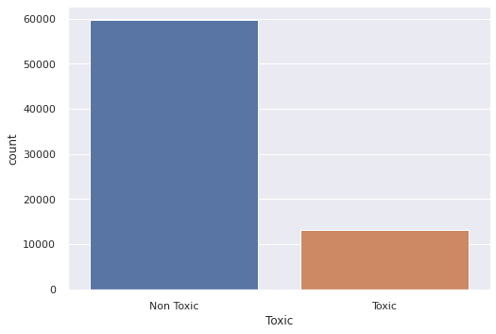
Dataset
Prepared an extensive dataset after manual correction & annotation for Toxicity detection in Urdu language.
72,771 Diverse samples.
59674 Non Toxic Samples
13097 Toxic Samples
Notes:
Prepared Large Dataset for urdu Toxicity detection having 72771 samples
59674 Non-Toxic
13097 Toxic

Slide 18
Data Annotation Guidelines
Team of three Annotators followed these annotation guidelines:
Do not modify any Roman Urdu sentence.
Only modify Urdu sentences if necessary.
Do not correct typos instead write a phonetically equivalent word for it in Urdu. For example, “mohadat” should not be converted to “محبت” but to “محدت”.
Normalize Hindi words to Urdu. For example, “jabardast” to “زبردست” and “jaroori” to “ضروری” “fatna” to “پھٹنا“
In case of acronyms/abbreviations, separate the characters with spaces. For example, “BJP” to بی جے پی” “PMLN” to “پی ایم ایل این”
Refer to context for homophones. For example:
“K” can be mapped to ‘کو’, ‘کی’, ‘کا’, ‘کے’, ‘کہ’‘
“Nae” can be mapped to ‘نے’, ‘نہیں’, ‘نئی’‘
“Ha” can be mapped to ‘ہے’, ‘ہاں’, ‘ہیں’
Notes:
These are the annotation guidelines that were decided beforehand.
- We didn’t modify anything in original Roman Urdu Sentence
- Only modified urdu sentence when needed
- Typing mistakes were not corrected but converted into urdu as such
- Hindi words were normalized into their corresponding Urdu
- Abbreviations were converted into Urdu with spaces among characters
- Homophones were dealt with the context of comment

Slide 19
Dataset Preparation & Annotation
Step 1 - Data Scraper for Automatic Transliteration of RU data to Urdu.
Step 2 - Manual Review of dataset to assess the quality.
- A lot of errors in automatic transliteration.
Step 3 - Data Annotation tool.
Step 4 - Manual Correction and Annotation of all the data.
Final Step - Final Review of data.
Notes:
The process of Collection and Annotation of Data Involved 5 steps
Step 1 was to Transliterate RU to Urdu by a written scraper using Ijunoon. There were a lot of errors in that transliteration
Step 2 was to manually review the Transliterated Dataset to verify quality
Step 3 We created annotation tool to help and ease the annotation and correction process of data.
Step 4 was to manually review each and every row of dataset carefully and correct the mistakes.
Last step was to verify the finalized dataset among the annotators.

Slide 20
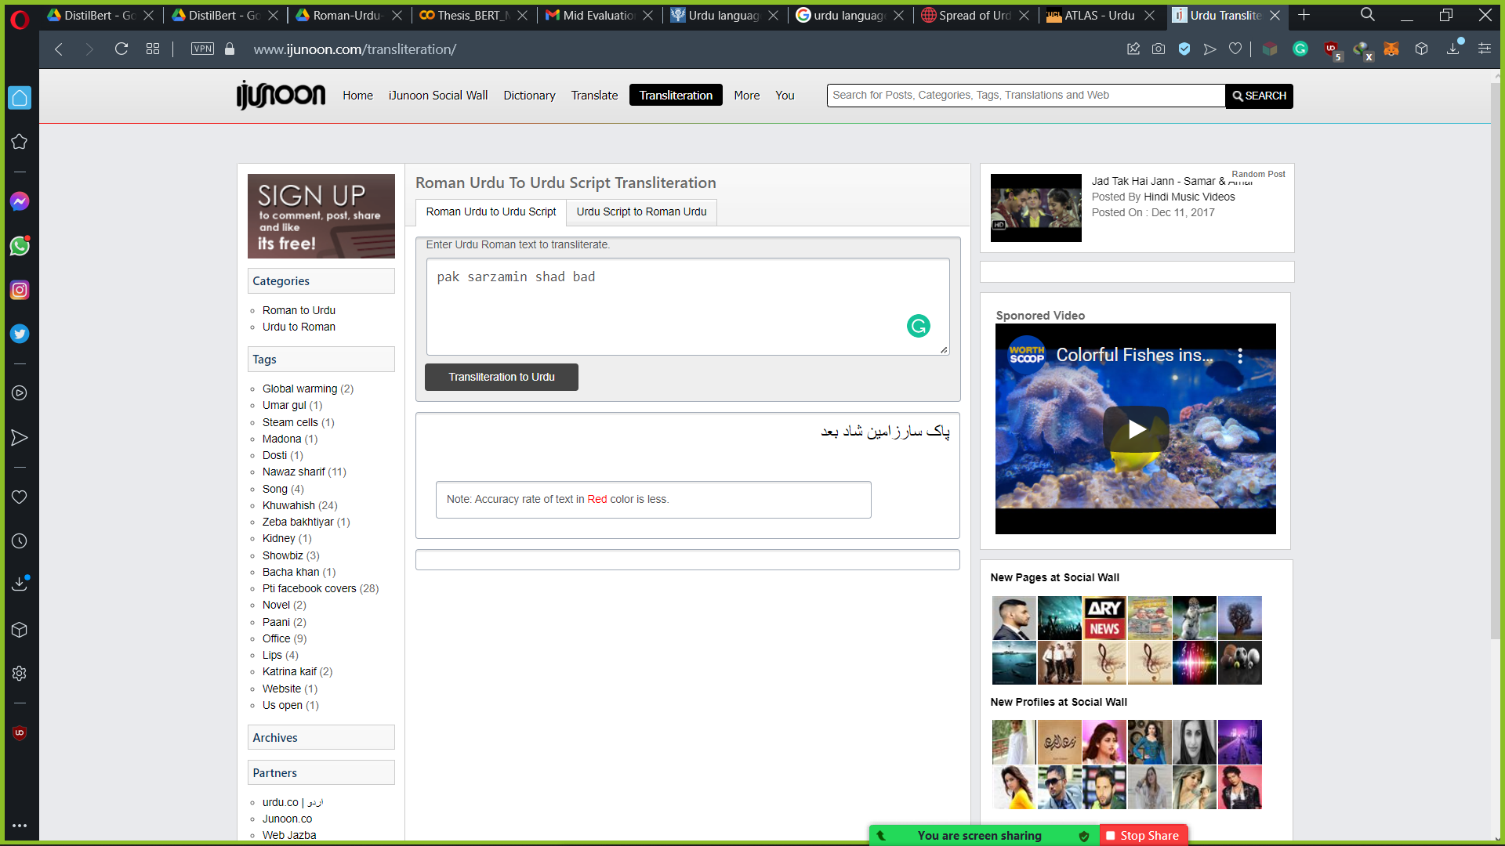
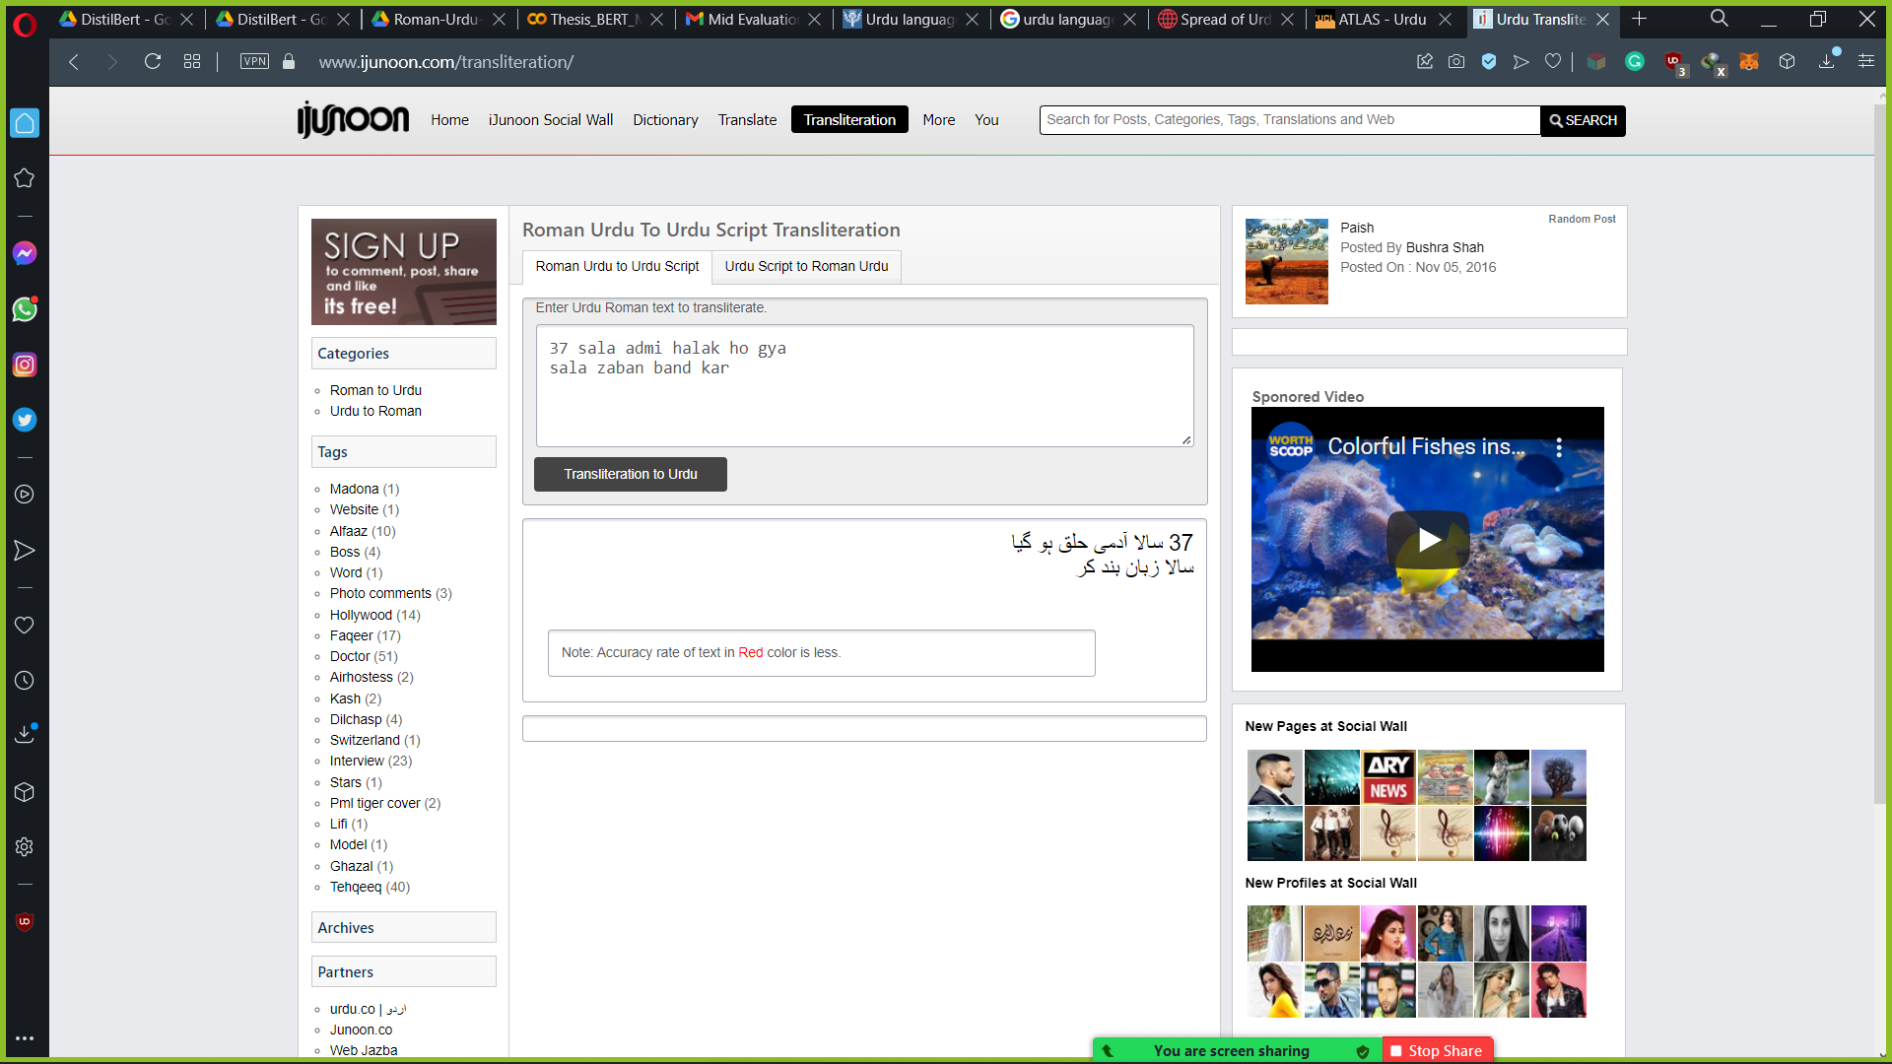
Example of Errors
Notes:
These are examples of mistakes that Ijunoon makes.
These are comparatively simple examples WHILE data has more complex and informal comments for both Toxic and Non-Toxic classes

Slide 21
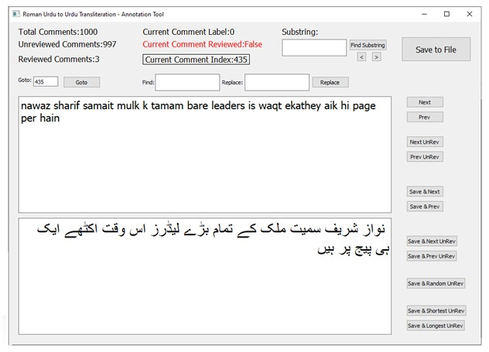
Annotation Tool

Slide 22
Dataset Pre-processing
After collection and annotation of data we cleaned and pre-processed our dataset
Duplicates removed.
Extra spaces removed.
Punctuation marks removed.
Accents removed.
Url and Numbers removed.
Diacritics removed.
Any English characters.
Removed empty rows from dataset.
Notes:
After finalizing the data and before experimentation.
We pre-processed the data.

Slide 23
Dataset Attributes
Raw Data
Classes | No of Samples | Max Length | Average Length | Vocabulary Size | Total Tokens
Toxic | 13097 | 197 | 17 ± 17.00 | 13203 | 226366
Non-Toxic | 59674 | 230 | 24 ± 20.38 | 49510 | 1446452
Total | 72771 | 230 | 22 ± 19.99 | 54477 | 1672818
Pre-processed Data
Classes | No of Samples | Max Length | Average Length | Vocabulary Size | Total Tokens
Toxic | 12812 | 149 | 14 ± 15.15 | 12567 | 182487
Non-Toxic | 58056 | 199 | 21 ± 19.03 | 47210 | 1233220
Total | 70868 | 199 | 19 ± 18.58 | 51707 | 1415707
Notes:
These are some attributes of the dataset before and after pre-processing
Shows No of samples, max length, average length, vocab size and tokens

Slide 24
Dataset Splits
Training – Testing Split
80 – 20 %
From the Training data, Training – Validation Split
90 – 10 %
Consistent Across all experiments.
Notes:
TELL HOW THE SPLIT IS DONE. CLEARLY !
We split our data into TWO sets TRAIN and TEST – 80/20 split
From the TRAIN set we further extracted VALIDATION set – 90/10 split

Slide 25
Classification Models
Machine Learning Based: with Tf-Idf
1. Naïve Bayes.
2. Random Forest.
3. Linear Regression.
4. Support Vector Machines
Deep Learning Based: with Word Embeddings
5. CNN George.
6. BGRU.
7. RCNN.
8. CNN GRU
9. Bi-LSTM
10. CNN modified
11. BGRU_P
Notes:
These are the models that we used in our experiments with different word embeddings

Slide 26
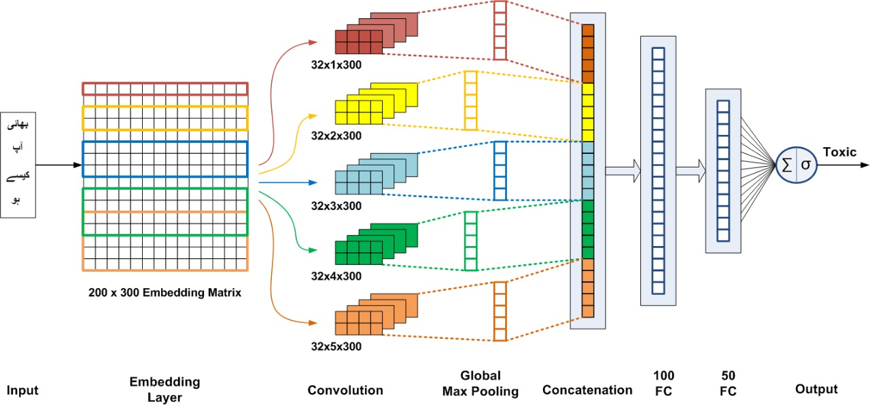
Architecture Diagram
Notes:
Diagram of Highest scoring Model Corpus-specific FastText + CNN Tweaked
32 FILTERS 32X1X300 300 FIX WIDTH 1 IS IT WILL SEE THE WORD SO ON WITH 2,3,4,5 WORDS

Slide 27
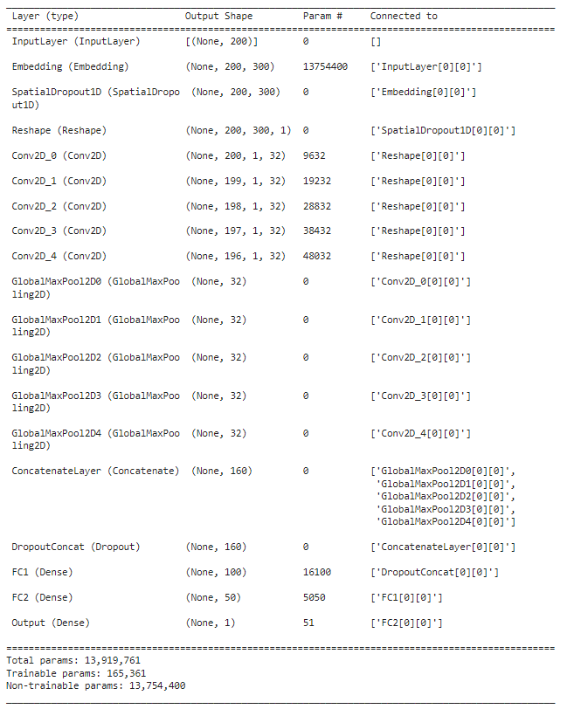
Layer-wise Parameters

Slide 28
Word Embeddings
4 Types of Word Embeddings
Pre-trained Urdu word embeddings provided by “FastText” and “BERT Multilingual”.
Fine-tuned pre-trained Urdu word embeddings provided by “FastText” and “BERT Multilingual”.
Word embeddings learnt as part of model training.
Corpus-specific FastText word embeddings
Notes:
We used approaches with word embeddings
Pretrained Fasttext and BERT multilingual embeddings
Finetuned the pretrained Fasttext and BERT embddings
Learnt embeddings along with model training
Corpus-specific FastText word embeddings
Also tell why you didn’t train BERT Embeddings: because of less resources although we could’ve done that

Slide 29
Experimental Configurations
ML based
a. Tf-Idf vectorizers.
DL based: Pre-trained word embeddings.
a. FastText Urdu embeddings.
b. BERT Multilingual embeddings.
DL based: Embeddings learnt during model training.
DL based: Finetuned word embeddings.
a. FastText Urdu embeddings.
b. BERT Multilingual embeddings.
DL based: Corpus-specific word embeddings.
a. FastText Urdu embeddings.
Notes:
IMPORTANT
Explain this slides. WHY so many experiments? Because we have standard text classification models like given. Pre-trained Word embeddings are for urdu standard Fasttext, BERT etc. We want to extract a combination that gives best F1 score for our specific problem i.e Urdu toxic comment classification.
Because wanted to compare the word embeddings too.

Slide 30
Hyper-parameters
Hyper Parameter Tuning
Embedding Size
[200, 300, 768]
Embedding Weights Initialization
['glorot_normal', 'glorot_uniform’, ‘He-Norm’, ‘He-uniform’]
Optimizer
['Adam', ‘Sgd’, ‘Rms Prop’]
Batch Size
[32, 64, 96, 128]
Initial Learning Rate
[1e-3, 1e-4, 1e-5]

Slide 31
Spacial Dropout Rate
[0.3, 0.4, 0.6, 0.65]
Decay Rate
[0.3, 0.4, 0.5]
Decay After
[3, 4, 5]
Lstm units (for blstm)
[100, 130, 150]
GRU units (for bgru)
[100, 130, 150]
No of layers (for rcnn)
[2]
Hidden size (for rcnn)
[32, 64]
Notes:
Add no of layers according to models
TUNED ON VALIDATION SET THEN FINAL

Slide 32
Results
1: ML Models: Tf-Idf vectors
Models | Accuracy | Precision | Recall | F1 Score
Tf-Idf+NB | 0.94186 | 0.85767 | 0.81349 | 0.835
Tf-Idf+RF | 0.93579 | 0.81874 | 0.82832 | 0.8235
Tf-Idf+LR | 0.95562 | 0.90974 | 0.83769 | 0.87223
Tf-Idf+SVM | 0.95886 | 0.91842 | 0.84783 | 0.87972

Slide 33
Results
2: DL Models: Pre-trained Embeddings
Experiment Set | Models | Accuracy | Precision | Recall | F1 Score
DL Model: FastText Pretrained | FastText+CNN_George | 0.94045 | 0.87288 | 0.78501 | 0.82662
 | FastText+BGRU_P | 0.94355 | 0.84994 | 0.83534 | 0.84258
 | FastText+CNN_GRU | 0.94299 | 0.86245 | 0.81467 | 0.83788
 | FastText+BLSTM | 0.9468 | 0.89549 | 0.79906 | 0.84453
 | FastText+BGRU | 0.94292 | 0.91563 | 0.7538 | 0.82687
 | FastText+CNN_Tweaked | 0.94017 | 0.86288 | 0.79555 | 0.82785
 | FastText+RCNN | 0.93862 | 0.823957 | 0.840031 | 0.83191
DL Model: BERT Pretrained | BERT+CNN_George | 0.93191 | 0.83515 | 0.77682 | 0.81493
 | BERT+CNN_GRU | 0.93466 | 0.8554 | 0.76863 | 0.81969
 | BERT+BLSTM | 0.93064 | 0.82456 | 0.78306 | 0.81328
 | BERT+BGRU | 0.92789 | 0.84474 | 0.73663 | 0.79699
 | BERT+CNN_Tweaked | 0.93149 | 0.83959 | 0.76785 | 0.83211
 | BERT+BGRU_P | 0.9396 | 0.85876 | 0.79711 | 0.82679
 | BERT+RCNN | 0.929659 | 0.81471 | 0.79087 | 0.812613

Slide 35
Results
3: DL Models: Trained with model
Models | Accuracy | Precision | Recall | F1 Score
CNN_George | 0.95527 | 0.89351 | 0.85446 | 0.87355
BGRU_P | 0.96013 | 0.9159 | 0.85836 | 0.8862
CNN_GRU | 0.95999 | 0.91583 | 0.85758 | 0.88575
BLSTM | 0.9595 | 0.93333 | 0.83573 | 0.88184
BGRU | 0.95505 | 0.86727 | 0.88724 | 0.87714
CNN_Tweaked | 0.95788 | 0.92664 | 0.833 | 0.88733
RCNN | 0.949978 | 0.86844 | 0.852516 | 0.8604

Slide 36
Results
4: DL Models: Finetuned Embeddings
Experiment Set | Models | Accuracy | Precision | Recall | F1 Score
DL Model: FastText Finetuned | FastText+CNN_Tweaked | 0.96126 | 0.93517 | 0.84432 | 0.88743
 | FastText+CNN_George | 0.9583 | 0.921 | 0.84159 | 0.87951
 | FastText+BGRU_P | 0.95943 | 0.90048 | 0.87202 | 0.88602
 | FastText+CNN_GRU | 0.96112 | 0.92772 | 0.85134 | 0.88719
 | FastText+BLSTM | 0.95823 | 0.9132 | 0.84978 | 0.88035
 | FastText+BGRU | 0.95971 | 0.9231 | 0.84783 | 0.88387
 | FastText+RCNN | 0.95731 | 0.9072 | 0.85095 | 0.87819
DL Model: BERT Finetuned | BERT+CNN_George | 0.95823 | 0.91459 | 0.84822 | 0.88016
 | BERT+BGRU_P | 0.95886 | 0.9308 | 0.83456 | 0.88306
 | BERT+CNN_GRU | 0.95823 | 0.91182 | 0.85134 | 0.88054
 | BERT+BLSTM | 0.95597 | 0.91063 | 0.83886 | 0.87327
 | BERT+BGRU | 0.95766 | 0.91501 | 0.84432 | 0.87824
 | BERT+CNN_Tweaked | 0.95872 | 0.9423 | 0.82208 | 0.88809
 | BERT+RCNN | 0.956116 | 0.91527 | 0.834568 | 0.873061

Slide 38
Results
5: DL Models: Corpus-specific Embeddings
Models | Accuracy | Precision | Recall | F1 Score
FastText+CNN_George | 0.96056 | 0.9175 | 0.85914 | 0.88736
FastText+CNN_GRU | 0.95886 | 0.9125 | 0.85446 | 0.88253
FastText+BLSTM | 0.95999 | 0.89291 | 0.8849 | 0.88888
FastText+BGRU | 0.96084 | 0.92184 | 0.85602 | 0.88772
FastText+CNN_Tweaked | 0.9643 | 0.91791 | 0.88138 | 0.89928
FastText+BGRU_P | 0.96211 | 0.92243 | 0.86305 | 0.89175
FastText+RCNN | 0.960349 | 0.9102 | 0.866172 | 0.887644

Slide 39
F1-Score Performance across all Experiment sets

Slide 40
Demo
True | Predicted | Comment
1 | 1 | ہاہاہا ہاہاہا ہاہاہا پاگل کا بچہ
1 | 1 | لعنت ہے اس ملک کے حکمرانوں پر
0 | 0 | بد قسمتی سے پاکستان ٹیم کے لیے ان کا انتخاب نا ہو سکا
1 | 1 | یہ بھونکنے والا ہے سعودی کے ریال کمانے کے لیے
0 | 1 | ذلیل کر دیا اس بچی کو سب نے
1 | 0 | آنٹی آپ سے ریکویسٹ ہے آپ جسٹ پوگو ہو ہی دیکھو کیوں کہ اس میں نواز گنجا کچھ زیادہ ہی آتا ہے
1 | 0 | دھاندلی کی پیداوار
Notes:
8 examples 4 wrong: small length 4 correct: small lenth from Toxic classes

Slide 41
Conclusion
Toxic comment classification Urdu which is an under-resourced language
Resource Generation
We have prepared a larger and much richer manually annotated corpus for urdu toxicity detection
Empirical Analysis
Compared different Deep Learning architectures along with pre-trained and corpus-specific embeddings.
FastText Corpus-specific embeddings gave highest F1 – score that is 89.92%
Notes:
Work on Urdu toxic comment classfication
Prepared dataset for Urdu
Compared Different existing architecture
Highest performance model FastText corpus specific with CNN Tweaked gives highest F1-score 89.92%

Slide 42
References
Basile, V., Bosco, C., Fersini, E., Nozza, D., Patti, V., Pardo, F.M.R., Rosso, P., & Sanguinetti, M.(2019). Semeval-2019 task 5: Multilingual detection of hate speech against immigrants and women in twitter.
Chung, Y., Kuzmenko, E., Tekiroglu, S. S., & Guerini, M. (2019). CONAN - counter narratives through niche sourcing: a multilingual dataset of responses to fight online hate speech. In A. Korhonen, D.R.Traum, L. Ma`rquez (Eds.)
Muhammad Moin Khan, Khurram Shahzad, and Muhammad Kamran Malik. 2021. Hate Speech Detection in Roman Urdu. ACM Trans. Asian Low-Resour. Lang. Inf. Process. (January 2021).
Ameer, I., Siddiqui, M. H.F ., Sidorov, G., & Gelbukh, A. F. (2019). CIC at semeval-2019 task 5: Simple yet very efficient approach to hate speech detection, aggressive behavior detection, and target classification in twitter. In J. May, E. Shutova, A. Herbelot, X. Zhu, M. Apidianaki, S. M. Mohammad (Eds.) Proceedings of the 13th International Workshop on Semantic Evaluation, SemEval@NAACL-HLT 2019. Minneapolis, MN, USA, June 6–7, 2019, pp. 382–386. Association for Computational Linguistics (2019).

Slide 43
Michele Corazza, Stefano Menini, Elena Cabrio, Sara Tonelli, and Serena Villata. 2020. A Multilingual Evaluation for Online Hate Speech Detection. ACM Trans. Internet Technol. 20, 2, Article 10 (2020).
Raza Ali, Umar Farooq, Umair Arshad, Waseem Shahzad, Mirza Omer Beg, Hate speech detection on Twitter using transfer learning, Computer Speech & Language. (2022).
M. Z. Ali, Ehsan-Ul-Haq, S. Rauf, K. Javed and S. Hussain, "Improving Hate Speech Detection of Urdu Tweets Using Sentiment Analysis," in IEEE Access, vol. 9, pp. 84296-84305, 2021, doi: 10.1109/ACCESS.2021.3087827.
Fatemah Husain and Ozlem Uzuner. 2022. Investigating the Effect of Preprocessing Arabic Text on Offensive Language and Hate Speech Detection. ACM Trans. Asian Low-Resour. Lang. Inf. Process. 21, 4, Article 73 (2022).
Xianbing Zhou, Yang Yong, Xiaochao Fan, Ge Ren, Yunfeng Song, Yufeng Diao, Liang Yang, and Hongfei Lin. 2021. Hate Speech Detection Based on Sentiment Knowledge Sharing. In Proceedings of the 59th Annual Meeting of the Association for Computational Linguistics and the 11th International Joint Conference on Natural Language Processing. (2021).
Saeed, H.H., Ashraf, M.H., Kamiran, F. et al. Roman Urdu toxic comment classification. Lang Resources & Evaluation 55, 971–996. (2021).
Britanica Stats

Slide 44
THANKS!
Any questions?
You can find me at
imusamairfan147@gmail.com

